Slide 1
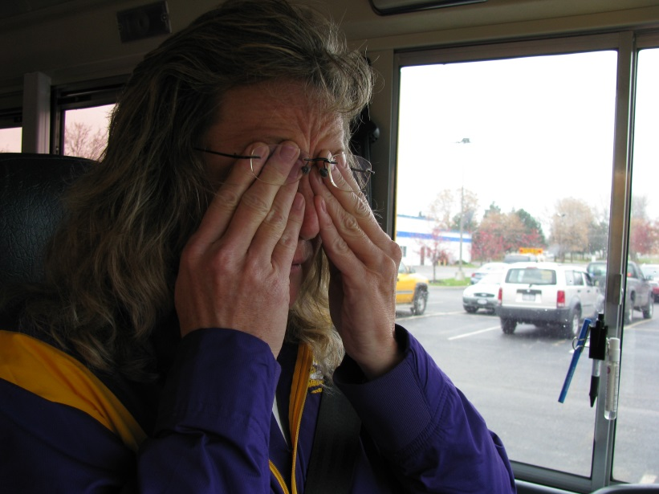
Drowsy Driving
Awareness and Prevention
Notes:
Instructor Notes:
Display this slide as participants enter the room to allow them to begin to think about this topic. It will also reassure them they are in the right place.
Cover the logistics of the facility before beginning, such as the emergency exits, restroom locations, and smoking policy.
Ask participants to silence cell phones and be respectful with side-conversations.

Slide 2
OUR THANKS!
“This educational program was funded by the National Highway Traffic Safety Administration with a grant from the New York Governor's Traffic Safety Committee"

Slide 3
N.Y.A.P.T.
The New York Association for Pupil Transportation has produced this educational program as part of a Highway Safety Grant provided through the Governor’s Traffic Safety Committee with NHTSA funding. (2017)
NYAPT wishes to thank the Pupil Transportation Safety Institute (PTSI) for its collaboration in the design and development of this educational offering.

Slide 4
Today’s Training Will Address…
Scope of the problem - data
Risk factors of drowsy driving
Warning Signs
Causes of fatigue
What Doesn’t work to prevent drowsiness
Sleep Disorders
Drowsy Driving Legislation
Notes:
Instructor Notes:
Briefly share what topic areas will be addressed within the overall topic of Drowsy Driving.

Slide 5
Scope of the Problem
6% of all crashes and 21% of all fatal crashes involved a fatigued driver
6,000 lives lost annually
30% of all drivers in the US have dozed off behind the wheel
* 2014 National Safety Council and AAA statistics
Notes:
Instructor Notes:
This slide serves to convince/inform your audience about the existence of a real problem with drowsy driving in our society today.
School bus drivers are not exempt from the risks of driving drowsy.

Slide 6
Effect on Driving
Fatigue = Reduced Safety Performance
Driving after only 4-5 hours of sleep = similar crash risk as driving legally drunk at .08 BAC
Drowsy driving is similar to drunk driving
Driving after sleeping only 5-6 hours a night nearly doubles your risk of having a crash
AAA Foundation 2016 statistics
Notes:
Instructor Notes:
Driving after only 4-5 hours of sleep puts drivers at risk for a crash.
It is not unusual for someone to only get 5 hours sleep – this means that at any given time of the day, you are faced with a potentially high occurrence of impaired driver.
Ask participants to think about a time when they found it difficult to sleep and slept 5 hours or less – yet continued to function. We’ve all been there.
However as professional school bus drivers, we must avoid being in that place for safety reasons.
Imagine the risk involved if the school bus driver AND the other motorist they encounter on the road both have had less than 5 hours s;leep!

Slide 7
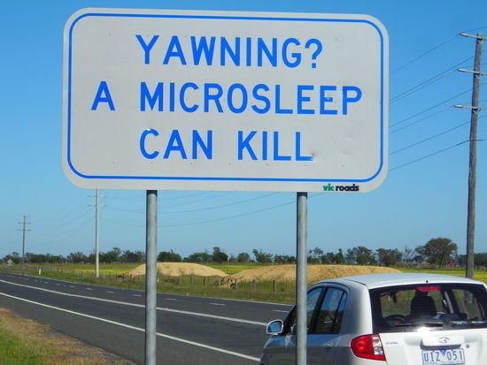
A Micro-sleep Can Kill You In Seconds…
In a 3 second micro-sleep, traveling 45 mph, your vehicle travels198 feet – 65 yards
4 average school bus lengths
More than half a football field
Notes:
Instructor Notes:
A micro-sleep is a temporary episode of sleep or drowsiness which may last for a fraction of a second or up to 30 seconds where an individual fails to respond to some arbitrary sensory input and becomes unconscious.
The distance traveled during a micro-sleep is alarming.
A school bus traveling 40 mph travels approximately 10 feet per second.
This helps to put the dangers in perspective for us.
Please note: The next slide will automatically display. It is a video clip describing micro-sleep.

Slide 8
Notes:
Instructor Notes:
Picture that changes – needs editing
Source Video: https://www.youtube.com/watch?v=tvfMOPTsU_0

Slide 9
Risk Factors for Driving Drowsy
Sleeping less than 7 hours in past 24 hours
Untreated sleep disorder
Obstructed sleep apnea or insomnia
Defy circadian rhythm
Shift work
Night driving
Driving long distances without breaks
Medication
Alcohol or illegal drug use
Notes:
Instructor Notes:
Briefly cover the risk factors which precede driving drowsy.
Each of these will be covered in greater detail in upcoming slides.
Refrain from teaching each of these identified areas of concern from this slide.

Slide 10
Warning Signs
Yawning or blinking frequently
Difficulty keeping your eyes open (2-3 second micro-sleeps)
Difficulty remembering the past few miles driven
Missing your exit
Missed road signs
Drifting from your lane
Hitting a rumble strip on the side of the road
No memory of having driven last section of road
Notes:
Instructor Notes:
As we are driving there are warning signs affiliated with becoming fatigued.
Awareness of each of these warning signs is a key factor in making decisions regarding when you are safe to drive.
Because we are school bus drivers, it is our responsibility and morale obligation to only drive when fit to do so safely.

Slide 11
Primary Cause of Drowsiness…
Fatigue
Sleep deprivation
Poor quality sleep
Circadian rhythm (time of day)
Let’s look at each of these in detail…
Notes:
Instructor Notes:
On the surface, the primary cause of being drowsy is a simple lack of sleep.
However upon further investigation, we find that a “simple” lack of sleep is not so simple.
Each will be discussed in greater detail in upcoming slides.

Slide 12
Sleep Deprivation
Lack of sleep
7-9 hours of sleep daily required
47% of US workforce is sleep deprived
Large part of population has untreated sleep disorders
Time awake
16 hours of being awake – your performance degrades significantly
Notes:
Instructor Notes:
We all need 7-9 hours of sleep each day. However there are things in our lives that sometimes prevent this from happening.
Engage the participants in a large group discussion regarding what things sometimes prevent us from getting 7-9 hours of sleep. List these on a flip chart and post in the classroom. We will refer to this list off and on during the training.

Slide 13
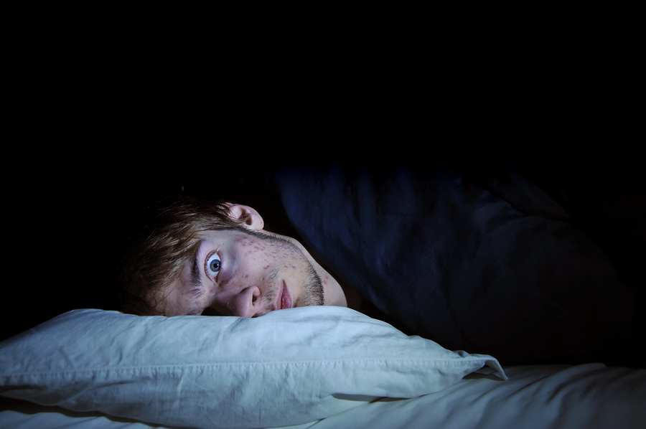
Poor Quality of Sleep
Insomnia
Restless or sick spouse in your bed
Noisy environment
Lights
High temperatures
Humidity
Uncomfortable or new sleep environment
Notes:
Instructor Notes:
There may be several reasons that you experience a poor quality of sleep.
Some examples are viewed here on this screen.
Insomnia is medical diagnosis defines as: habitual sleeplessness; inability to sleep.
In addition to these you may find that it is difficult to sleep when you are stressed about a personal issue:
Financial problems
Relationship difficulties
Children or family concerns
Work deadlines
Others?

Slide 14
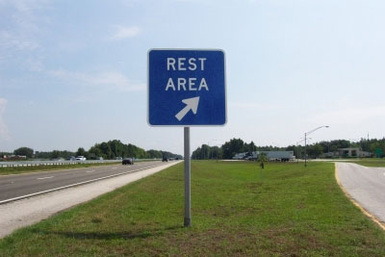
No Substitute for Rest
Get enough sleep
7-8 hours consecutive hours
Establish a bedtime and make it routine
Let people know what time you regularly go to bed and why it is important
Your body will establish an internal clock for your regular bedtime
Between runs – take a break/nap if possible
Notes:
Instructor Notes:
There is no substitute for rest to overcome fatigue. Get enough sleep. The average person needs 7-8 consecutive hours of sleep to awake rested. Establish a bedtime and make it routine. Your body will establish patterns of preparedness for your regular bedtime.
Let people know what time you regularly go to bed and why it is important for you to maintain your routines. The safety of your students is at stake and is not to be taken lightly.
Between runs – take a break. Go for short walks, sit in the cool air, or if time permits, take a “power nap.”

Slide 15
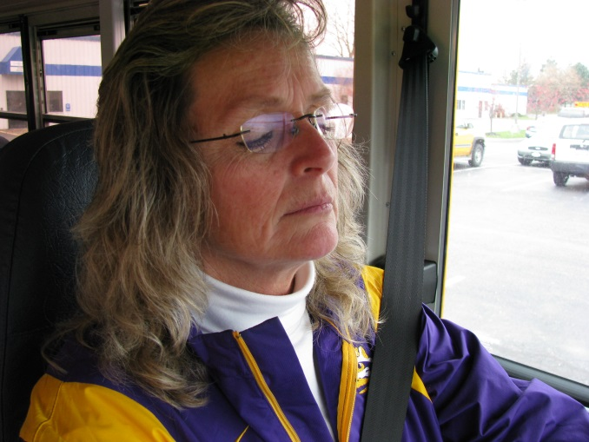
Driver Fatigue
When we are tired we make mistakes
Reduces ability to focus
Slows physical/mental skills
Response time
Concentration
Awareness
Attitude
Notes:
Instructor Notes:
Driver fatigue is a very dangerous condition. Fatigued drivers can experience a hypnotic effect that diminishes attention, or they fall asleep and make serious and sometimes fatal driving errors.
Tiredness and fatigue can often affect your driving ability long before you consciously realize you are tired or fatigued.
Fatigue-related crashes are often more severe than others because drivers' reaction time is delayed or they have failed to make maneuvers to avoid a crash.
Symptoms of driver fatigue include heavy eyelids, frequent yawning, a drifting vehicle that wanders over road lines, varying vehicle speed for no reason, misjudging traffic situations, seeing things "jump out" in the road, feeling fidgety or irritable and daydreaming.
Fatigue Reduces:
Ability to focus
Physical/mental skills
Response time
Concentration
Awareness

Slide 16
Circadian Rhythm
Circadian Rhythm
Sleep/wake cycle corresponds to time of day
Everyone follows this natural cycle
Circadian lows between 10pm and 7am
Also experience a biological clock dip between 2pm and 3pm
Being awake during these times is challenged by our body’s natural response to circadian lows
Notes:
Instructor Notes:
The circadian rhythm is a natural phenomenon that regulates our bodies and how our energy levels respond over the course of the day.
It is important to be aware of the highs and lows of this cycle as it relates to the time you will be driving a school bus.
Most school bus drivers begin their afternoon route approximately 2:00pm and typically finish about 4:00pm. A great deal of the time behind the wheel in the afternoon is spent during this natural dip in energy.

Slide 17
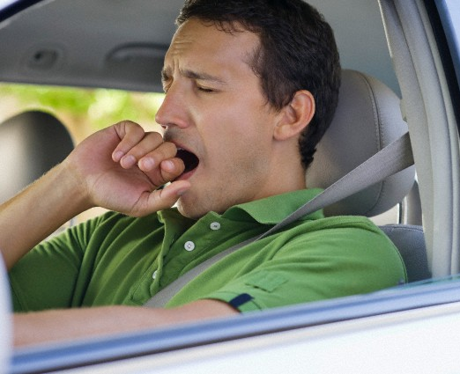
Post Lunch Slump
Beware the post lunch slump
After eating (assumed to be noon)
Carbohydrate overload can cause dip from approximately 1pm to 3pm
Be aware of your body and sleep needs
Schedule routine power nap before afternoon routes
Notes:
Instructor Notes:
Be aware of your body's reaction to foods. For example, carbohydrates can make you feel a slump in energy.
Consuming large meals slows us down, making us feel drowsy.
You may need to deliberately schedule a nap after lunch in preparation for afternoon routes.

Slide 18
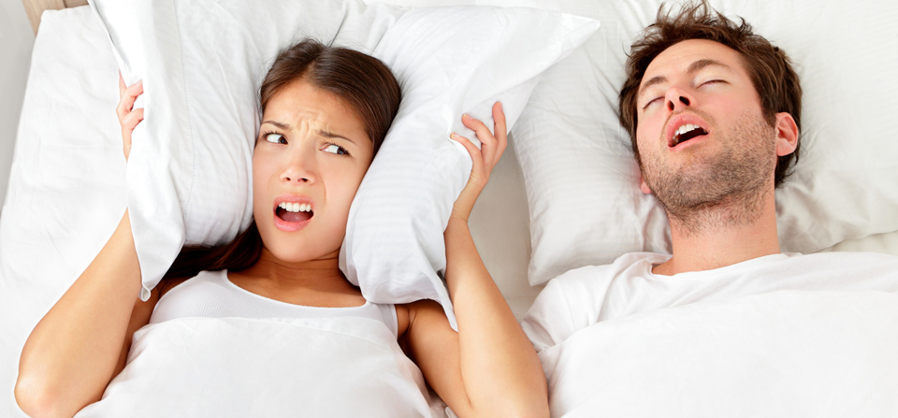
Sleep Apnea
Disruption of breathing while asleep
90% of people who have sleep apnea don't know they have it!
If left untreated, this common disorder can be life-threatening.
Notes:
Instructor Notes:
Sleep Apnea is a common disorder in which you have one or more pauses in breathing or shallow breaths while you sleep. Breathing pauses can last from a few seconds to minutes, often occurring 5 to 30 times or more an hour. Typically, normal breathing then starts again, sometimes with a loud snort or choking sound.
Sleep Apnea usually is a chronic (ongoing) condition that disrupts your sleep 3 or more nights each week. You often move out of deep sleep and into light sleep when your breathing pauses or becomes shallow.
This results in poor sleep quality, which makes you tired during the day. Sleep Apnea is one of the leading causes of excessive daytime sleepiness. Ninety percent of people who have Sleep Apnea don't know they have it, and if left untreated, this common disorder can be life-threatening.

Slide 19
Sleep Apnea Symptoms
Frequent silences during sleep due to breaks in breathing (apnea)
Choking or gasping during sleep to get air into the lungs
Loud snoring
Sudden awakenings to restart breathing or waking up in a sweat
Daytime sleepiness and feeling unrefreshed by a night’s sleep, including falling asleep at inappropriate times
Notes:
Instructor Notes:
Symptoms, of course, will vary somewhat from person to person; but in general the symptoms are:
Frequent silences during sleep due to breaks in breathing (apnea)
Choking or gasping during sleep to get air into the lungs
Loud snoring
Sudden awakenings to restart breathing or waking up in a sweat
Daytime sleepiness and feeling unrefreshed by a night’s sleep, including falling asleep at inappropriate times
Typically a spouse or partner who shares a bedroom or bed will notice these symptoms and tell you about it - don’t disregard their reports.
If you regularly become tired during the day, you may want to seek the advice of your doctor.

Slide 20
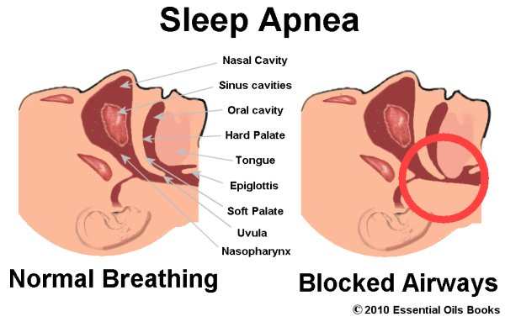
What Happens?
When you stop breathing during sleep due to sleep apnea, the balance of oxygen and carbon dioxide in the blood is upset.
The brain signals you to wake up so the muscles of the tongue and throat can increase the size of the airway.
These waking episodes are necessary to restart breathing (and to save your life).
You may not remember, but these episodes disrupt your sleep and cause daytime exhaustion.
Notes:
Instructor Notes:
When you stop breathing during sleep due to Sleep Apnea, the balance of oxygen and carbon dioxide in the blood is upset.
The brain signals you to wake up so the muscles of the tongue and throat can increase the size of the airway.
These waking episodes are necessary to restart breathing (and to save your life). You may not remember, but these episodes disrupt your sleep and cause daytime exhaustion.

Slide 21
Two Types of Sleep Apnea
Obstructive Sleep Apnea (OSA)
OSA is the most common type of sleep apnea. It is caused by a breathing obstruction, which stops the air flow in the nose and mouth.
Central Sleep Apnea (CSA)
Central sleep apnea (CSA), less common than OSA, is a central nervous system disorder that occurs when the brain signal telling the body to breathe is delayed. CSA can be caused by disease or injury involving the brainstem, such as a stroke, a brain tumor, a viral brain infection, or a chronic respiratory disease. People with CSA seldom snore.
Notes:
Instructor Notes:
Obstructive Sleep Apnea (OSA):
OSA is the most common type of Sleep Apnea. It is caused by a breathing obstruction, which stops the air flow in the nose and mouth.
Central Sleep Apnea (CSA):
CSA, less common than OSA, is a central nervous system disorder that occurs when the brain signal telling the body to breathe is delayed. CSA can be caused by disease or injury involving the brainstem, such as a stroke, a brain tumor, a viral brain infection, or a chronic respiratory disease. People with CSA seldom snore.

Slide 22
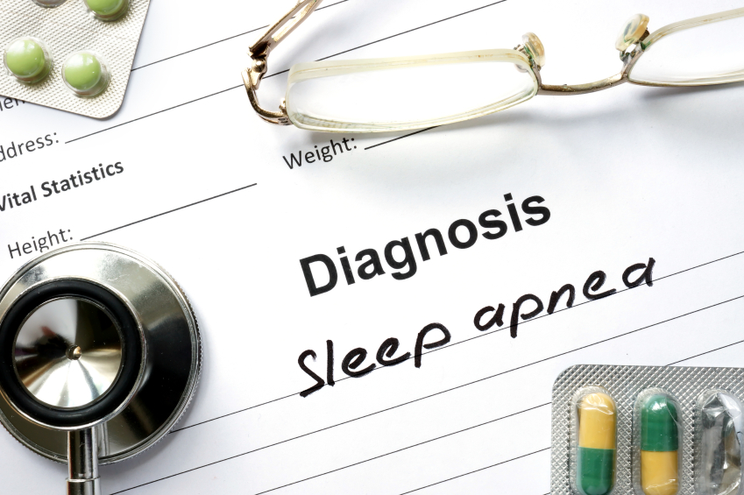
Effects of Sleep Apnea
Sleep apnea has serious health consequences and can even be life-threatening.
The main effects of sleep apnea are:
sleep deprivation
oxygen deprivation
Notes:
Instructor Notes:
Sleep Apnea has serious health consequences and can even be life-threatening.
The main effects of Sleep Apnea are:
Sleep deprivation
Oxygen deprivation

Slide 23
Sleep Deprivation
Frequent waking causes fitful sleep and prohibits therapeutic rest.
Apnea episodes have side effects like excessive sweating and a frequent need to urinate which disrupt sleep.
Awake feeling like you have not slept or have difficulty staying awake during the day.
Some trickle-down effects include a compromised immune system, poor mental and emotional health, and irritability.
Notes:
Instructor Notes:
Sleep Deprivation
Frequent waking during the night causes fitful sleep and prohibits therapeutic rest. Apnea episodes have side effects like excessive sweating and a frequent need to urinate which disrupt sleep.
People who have apnea episodes awake feeling like they have not slept or have difficulty staying awake during the day. Some trickle-down effects include a compromised immune system, poor mental and emotional health, and irritability.

Slide 24
Oxygen Deprivation
When you stop breathing, your brain does not get enough oxygen.
Serious problems can result from the oxygen deprivation of sleep apnea, including heart disease, high blood pressure, sexual dysfunction, and learning/memory problems.
Notes:
Instructor Notes:
Oxygen Deprivation: When you stop breathing, your brain does not get enough oxygen. Serious problems can result from the oxygen deprivation of Sleep Apnea, including heart disease, high blood pressure, sexual dysfunction, and learning/memory problems.

Slide 25
Depression and Sleep Apnea
Approximately 1 in 5 people who suffer from depression also suffer from sleep apnea
People with sleep apnea are 5 times more likely to become depressed.
Sleep Apnea may worsen existing depression.
While it is not clear whether the apnea causes the depression or vice-versa, studies show that by treating sleep apnea symptoms, depression may be alleviated in some people.
Notes:
Instructor Notes:
Approximately 1 in 5 people who suffer from depression also suffer from Sleep Apnea. People with Sleep Apnea are 5 times more likely to become depressed.
Existing depression may also be worsened by Sleep Apnea. While it is not clear whether the apnea causes the depression or vice-versa, studies show that by treating Sleep Apnea symptoms, depression may be alleviated in some people.

Slide 26
Self-help Treatment for Mild Sleep Apnea
Lose weight: Overweight individuals who lose even 10% of their weight can reduce sleep apnea and improve sleep quality.
Stop using alcohol, tobacco, and sedatives: avoid anything that relaxes the muscles of the throat and encourages snoring.
Sleep on your side: Special pillows or remedies that encourage side-sleeping might help people who only experience sleep apnea when they sleep on their back.
Elevate the head of your bed 4 to 6 inches: This can alleviate snoring and make breathing easier.
Maintain regular sleep hours: create a routine and stick to it.
Use a nasal dilator, nasal congestion strips, or saline nasal spray: these will help to open nasal passages.
Notes:
Instructor Notes:
Emphasize that self-treatment is not recommended – if you are experiencing the signs of sleep apnea – seek the advice of your physician.
Lose weight. This is challenging for some people, but even the slightest reduction in weight can help reduce the effects of mild sleep apnea.
Stop using alcohol, tobacco, and sedatives, or anything that relaxes the muscles of the throat and encourages snoring – avoid cocktails before bedtime.
Sleep on your side. Special pillows or remedies that encourage side-sleeping might help people who only experience Sleep Apnea when they sleep on their back.
Elevate the head of your bed 4 -6 inches. This can alleviate snoring and make breathing easier.
Maintain regular sleep hours.
Use a nasal dilator, such as nasal congestion strips or saline nasal spray to help open nasal passages.

Slide 27
Chronic Fatigue Syndrome (CFS)
Chronic Fatigue Syndrome (CFS) is a condition of prolonged and severe tiredness or weariness (fatigue) that is not relieved by rest and is not caused directly by other conditions. To be diagnosed with this condition, your tiredness must be severe enough to decrease your ability to participate in ordinary activities by 50%.
Notes:
Instructor Notes:
Chronic Fatigue Syndrome (CFS) is a condition of prolonged and severe tiredness or weariness (fatigue) that is not relieved by rest and is not caused directly by other conditions.
To be diagnosed with this condition, your tiredness must be severe enough to decrease your ability to participate in ordinary activities by 50%.

Slide 28
CFS Diagnosis
Fatigue or tiredness, never experienced to this extent before (new onset), lasting at least 6 months and not relieved by bed rest
Fatigue severe enough to restrict activity (serious fatigue develops with less than one-half of the exertion compared to before the illness)
There are no specific tests to confirm the diagnosis of CFS, though a variety of tests are usually done to exclude other possible causes of the symptoms.
Notes:
Instructor Notes:
A diagnosis of CFS most often meets the following criteria:
Fatigue or tiredness, never experienced to this extent before (new onset), lasting at least 6 months and not relieved by bed rest.
Fatigue severe enough to restrict activity (serious fatigue develops with less than one-half of the exertion compared to before the illness.
There are no specific tests to confirm the diagnosis of CFS, though a variety of tests are usually done to exclude other possible causes of the symptoms.

Slide 29
CFS Symptoms
Fatigue lasting more than 24 hours after normal exertion
Feeling unrefreshed after adequate sleep
Forgetfulness or other similar symptoms including difficulty concentrating, confusion, or irritability
Headaches, different from previous headaches in quality, severity, or pattern
Joint pain, often moving from joint to joint
Lymph node tenderness in the neck or armpit
Mild fever (101 degrees F or less)
Muscle aches
Unexplained muscle weakness
Sore throat
Notes:
Instructor Notes:
Fatigue, also known as weariness, tiredness, exhaustion, or lethargy, is generally defined as feeling a lack of energy. Fatigue is not the same as drowsiness, but the desire to sleep may accompany fatigue.
Symptoms, of course, will vary from person to person. However, the symptoms identified most often are:
Fatigue lasting more than 24 hours after normal exertion
Feeling unrefreshed after adequate sleep
Forgetfulness or other similar symptoms including difficulty concentrating, confusion, or irritability
Headaches, different from previous headaches in quality, severity, or pattern
Joint pain, often moving from joint to joint
Lymph node tenderness in the neck or armpit
Mild fever (101 degrees F or less)
Muscle aches
Unexplained muscle weakness
Sore throat

Slide 30
Medications
Become a label reader!
Any medication that identifies a side effect of drowsiness – heed the warning!
Modify dosage schedule so drowsiness happens at night when you are not going to be driving a school bus
Ask your physician is there is an alternative medication that does not cause drowsiness
Beware over the counter medications as well – read the label carefully
Notes:
Instructor Notes:
Emphasize to the participants that it is critically important to read the labels of medications – both prescribed and over the counter medications.
Avoid medications which indicate drowsiness as a side-effect.
Look for alternative medications, or avoid driving.

Slide 31
When You Experience Warning Signs
Stop driving immediately
Pull over in a safe place
Walk around the vehicle and take in fresh air
Nap for 10-20 minutes if possible
If warning signs persist - Notify your dispatch
Notes:
Instructor Notes:
Sometimes even the most prepared driver can be caught off-guard. If you begin to experience drowsiness or the precursors to drowsiness, stop driving immediately.
Remember - micro-sleeps happen very quickly and can be very dangerous.

Slide 32
What You Can Do to Prevent Drowsy Driving…
Get at least 8 hours sleep daily
Avoid driving during the times you are normally sleeping
Avoid medications whose side-effect is drowsiness
Keep temperatures in driver’s compartment cool
During long trips take a break every 2 hours (or sooner if warning signs are present)
Notes:
Instructor Notes:
The most effective preventative measure to avoid drowsiness is to sleep.
Get appropriate amounts of rest or consider your fitness for duty to drive a school bus!
Make adjustments in the drivers compartment to assist with staying alert.

Slide 33
Awareness if Key
Awareness of the risks and your body’s reaction to sleep deprivation is key
Our society spins at a faster pace than ever before
Sleep deprivation becomes a way of life
But for a school bus driver, there is so much more riding on your good nights sleep
Notes:
Instructor Notes:
Being aware of the potential for fatigue and drowsiness while behind the wheel of a school bus is key to prevention.
Take steps to routinely get adequate rest.
The stakes are a little higher – you are responsible for children’s lives.

Slide 34
Make it Routine…
Create good sleep routines and follow them
When you are fatigued – choose not to drive
If you experience the warning signs while driving you bus – pull over and notify dispatch
No matter what you think the consequences will be – they will be less than if you cause a crash and kill a child
Driving when you are sleepy or tired is risking your life and the lives of your students
Notes:
Instructor Notes:
Develop good sleep habits and attend to it with the same dedication as all the other preparations we make as school bus drivers.
Just as the pre-trip inspection indicates the bus is ready to serve children – we too must be ready to serve children.
Making proper sleep a priority is a must as a professional school bus driver.

Slide 35
Thank you!
Notes:
Instructor Notes:
Ask participants if they have any questions or comments.
Thank them for participating g in this training. Instructor Notes:

